Slide 2
Network Testing: Taming the Beast
Adam Dare
Software Design Engineer in Test
Xbox Platform Team
Microsoft

Slide 3
Agenda
Terminology
LIVE Parties Overview
Tools
Q&A

Slide 4
Terminology
Bandwidth
Upload: From local to remote
Download: From remote to local
Latency
Round-trip
Packet Loss
Port
Port Forwarding
UPnP

Slide 5
Terminology (cont’d)
NAT (Network Address Translation)
Allows single internet facing IP address to be used by multiple network devices
Maps internet IP address + Port # to internal IP address + Port #
Types of NATs:
Open: Router doesn’t care which port or IP address a return packet comes from, it just forwards the packet on.
Moderate: Router requires the port on the return packet to be the same as originally sent, but doesn’t care about the IP address.
Strict: Router requires the port AND IP address on the return packet to be the same as originally sent.

Slide 6
Terminology (cont’d)
NAT (Cont’d)
Connectivity Chart
 | Open | Moderate | Strict
Open
Moderate
Strict

Slide 7
Terminology (cont’d)
Peer-to-Peer Network
Full Mesh
Partial Mesh
Open
Open
Open
Open
Strict
Moderate
Open
Moderate

Slide 8
LIVE Parties Overview
System feature
Title independent up to 8-way voice chat
Limited CPU and memory restrictions
Limited to 36Kbps upload bandwidth
Sends mostly voice network traffic
Ties into Xbox 360 QNet/XRNM networking interfaces

Slide 9
LIVE Parties Overview (cont’d)
Xbox LIVE Statistics 11/01/09 – 12/01/09
NAT Usage
Open: 74%
Moderate: 21%
Strict: 5%

Slide 10
Tools
Network Emulator
Network Emulator for Windows Toolkit
Comes with Xbox 360 XDK
NEWT
Internet

Slide 11
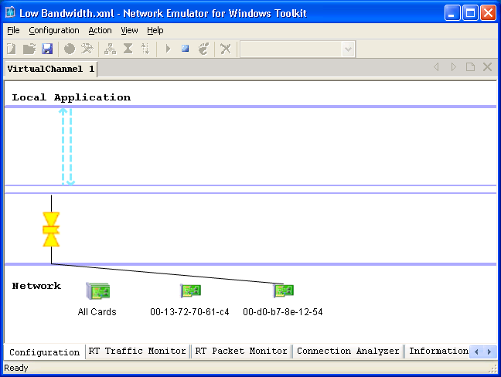
Tools
Network Emulator
Network Emulator for Windows Toolkit
Comes with Xbox 360 XDK
Network Traffic Settings
Machine Filter
Network Adapters

Slide 12
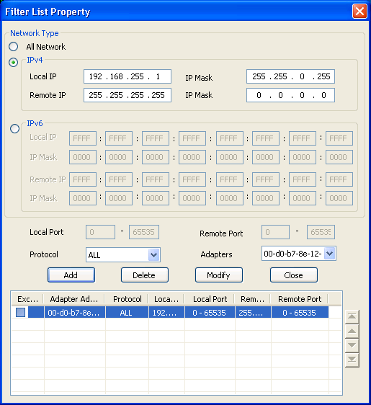
Tools
Network Emulator
Network Emulator for Windows Toolkit
Comes with Xbox 360 XDK

Slide 13
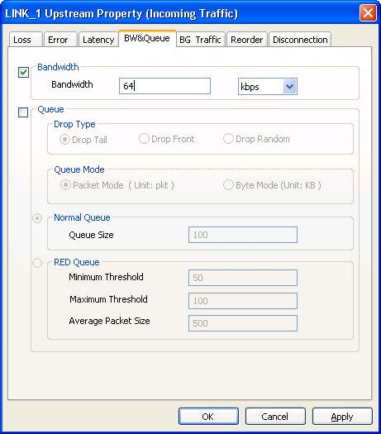
Tools
Network Emulator
Network Emulator for Windows Toolkit
Comes with Xbox 360 XDK

Slide 14
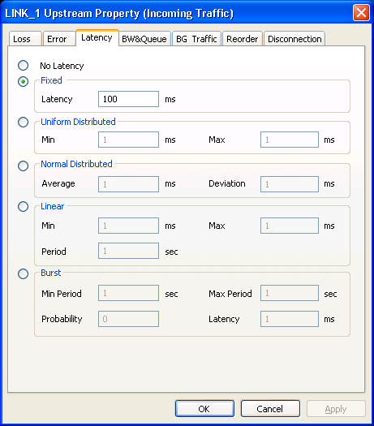
Tools
Network Emulator
Network Emulator for Windows Toolkit
Comes with Xbox 360 XDK

Slide 15
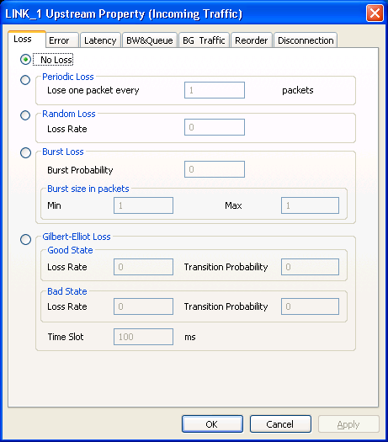
Tools
Network Emulator
Network Emulator for Windows Toolkit
Comes with Xbox 360 XDK

Slide 16
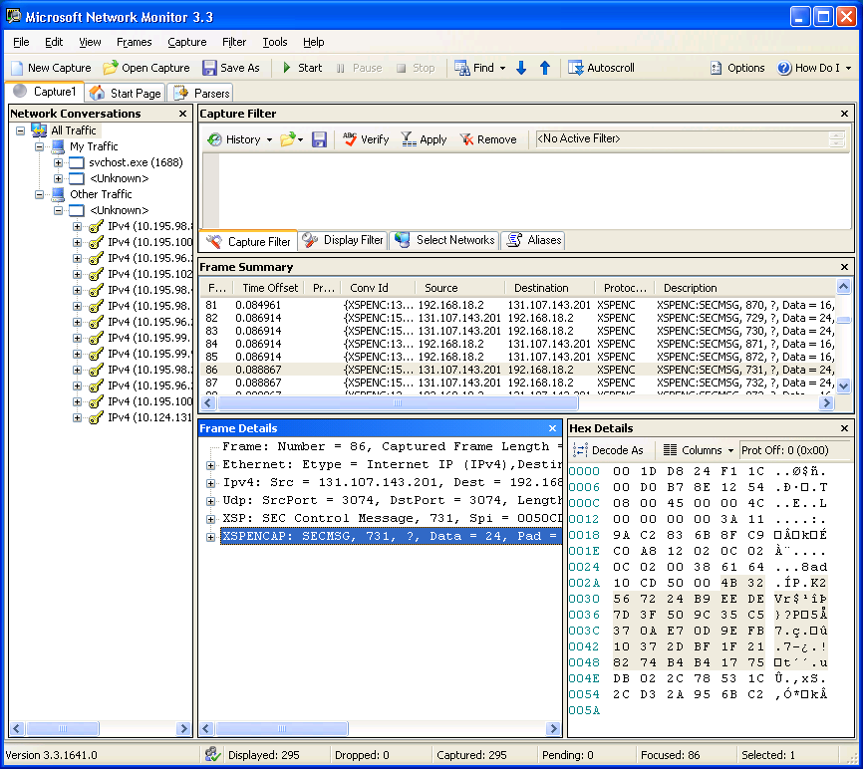
Tools (cont’d)
Network Monitor
NetMon
Comes with Xbox XDK

Slide 17
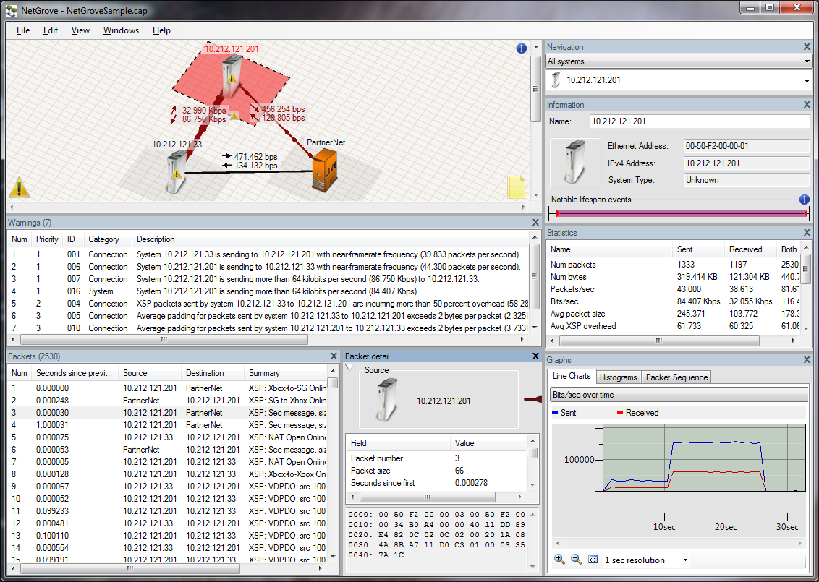
Tools (cont’d)
Network Traffic Visualizer
NetGrove Network Packet Analyzer
Comes with Xbox 360 XDK

Slide 18
Demo

Slide 19
Tools (cont’d)
Controlled environment
Test hooks and debug features
Enabling test automation
Record/playback
Disabling network traffic encryption
Logging
Instrumentation
Code profilers
Code coverage

Slide 20
Q & A

